Slide 1

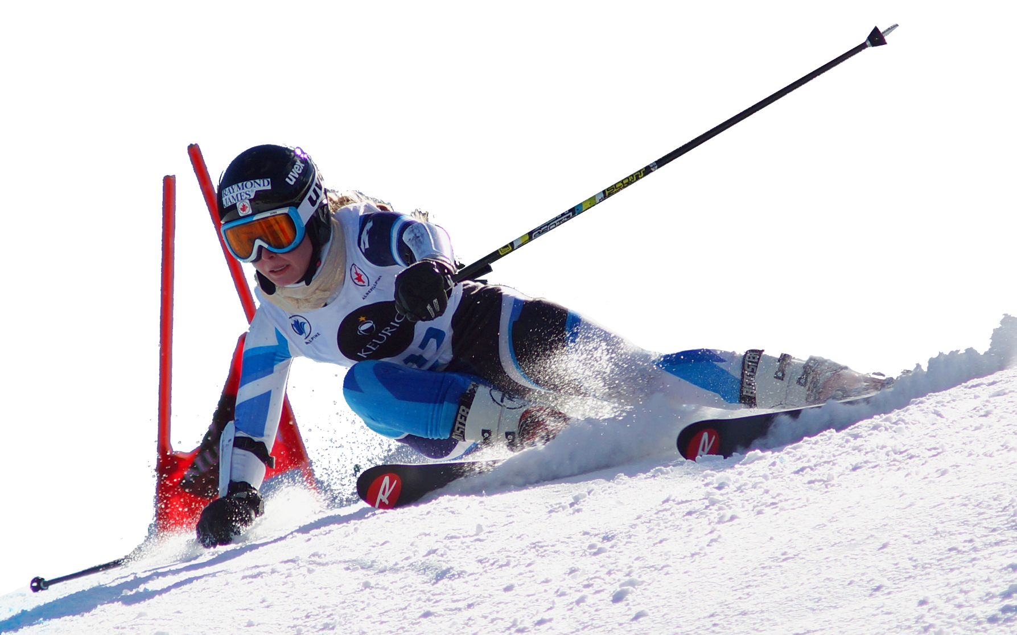
2016
SPONSORSHIP OPPORTUNITY
SUPPORT SKI RACING IN ALBERTA

Slide 2

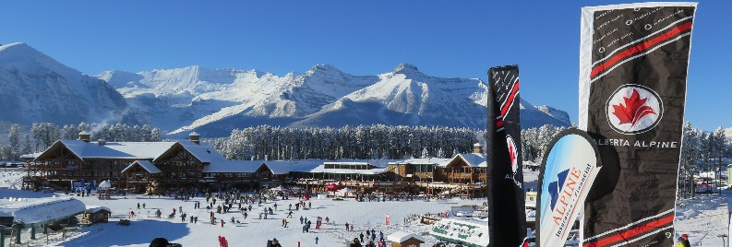
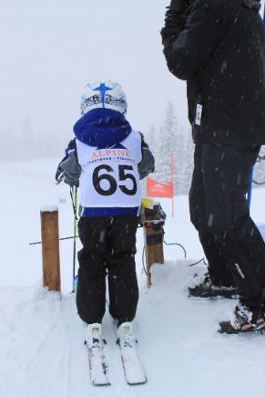
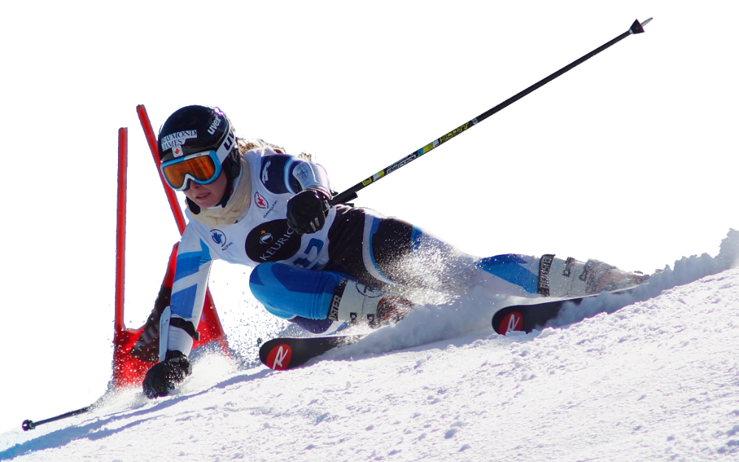
2016
SPONSORSHIP OPPORTUNITY
SUPPORT SKI RACING IN ALBERTA
Alberta Alpine Ski Association, more commonly known as Alberta Alpine, is the proud provincial partner of Alpine Canada Alpin and the governing body for alpine ski racing in the province of Alberta.
Alberta Alpine provides leadership and support services for the athletes, coaches, volunteers, officials and families who comprise the membership of over 4,800
Alberta Alpine Ski Association represents a large and active segment of the outdoor sport enthusiast market with a broad and impactful presence across all of Alberta and beyond.
Our Membership at a Glace
Over 4,800 total members and 38 member clubs located across the province,
87% university educated (43% with post-grad); 57% with household income > $150k
The organization relies on thousands of volunteer hours to host 100 + event days around the province annually
Race results, photos, and news posted on www.albertaalpine.ca after every event that takes place in Alberta
Key web stats (last twelve months):
160,000 visitors
700,000 page views
Average visit duration of 5:02
Alberta Alpine manages and delivers programs from introductory levels to masters, including the athletes of the Alberta Ski Team
Alberta has had a rich legacy of success - 80 Albertans have represented Canada on the world stage including Olympic medalists Jan Hudec, Edi Podivinsky and Karen Percy, World Champion John Kucera and World Cup medalists, Ken Read, Thomas Grandi, Jungle Jim Hunter, and Cary Mullen
Be Part of The Team Several sponsorship options are currently available and provide an excellent opportunity to create market awareness and brand promotion within our clubs, resorts and communities.

Slide 3
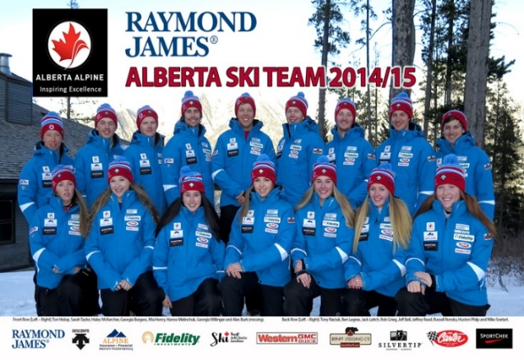
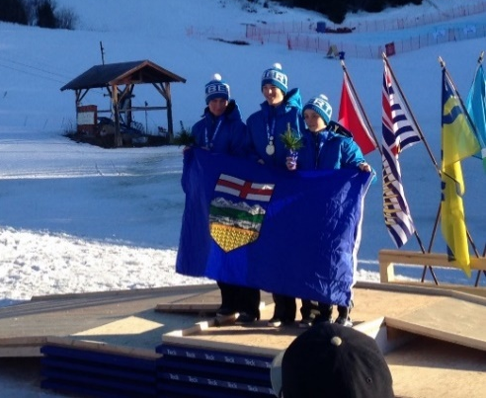
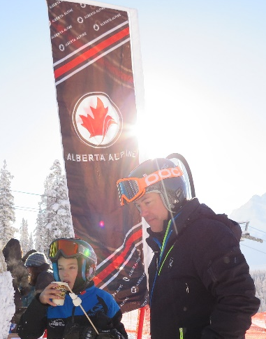
2016
SPONSORSHIP OPPORTUNITY
SUPPORT SKI RACING IN ALBERTA
The Alberta Ski Team (AST) is an athlete-centered, high performance development program that provides enhanced training and competitive opportunities for Alberta’s top performing alpine ski racers. The primary goal of the AST program is to advance athletes to Canadian Alpine Ski Team (CAST) programs.
Alberta Ski Team travels, trains and competes at prestigious resorts across North America and around the world from Oregon to Europe in the summer months and from home to Colorado and Quebec in the winter.
Alberta Ski Team travels in our Western GMC vehicles a total of over 80,000 km each year to ski areas across Canada and the United States.
Alberta Ski Team alumni currently represent Canada on our Canadian Alpine Ski Team and Canadian Ski Cross Team: Jan Hudec, Trevor Philp, Erik Read, Jocelyn McCarthy, Brady Leman and Tristan Tafel.
Highlights from 2014-15 Season
Record high membership: 4,800+ province-wide
Athletic pipeline is stronger than ever
7 of 18 Alpine Skiing medals at the 2015 Canada Winter Games in Prince George, BC (3 Gold medals)
Jocelyn McCarthy and Jeffrey Read represent Canada at the 2015 FIS Alpine Junior World Ski Championships in Hafjell, Norway
U16 athletes Stephanie Profitt and Liam Wallace represent Canada at the FIS International Children's ski races in Topolino, Italy
Trevor Philp and Erik Read win Silver Medals in the 2015 FIS Alpine World Skiing Championships
Building Relationships That Matter
Alberta Alpine understands that for many corporate sponsors, the underlying sponsorship objectives extend well beyond simple branding, logo recognition and affiliation and as such, the importance of corporate objectives such as community outreach and employee engagement cannot be overlooked. We are pleased to work hand-in-hand with our partners to develop strategic activation programs that allow our sponsors to leverage their sponsorship investment and achieve optimal return on their sponsorship objectives.

Slide 4



2016
SPONSORING & SUPPORTING SKI RACING IN ALBERTA
AVAILABLE PROPERTIES & OPPORTUNITIES
 | ALBERTA RACE SERIES |  |  |  |  | ALBERTA ALPINE EVENTS |  |  | TEAM ALBERTA | SPECIAL PROJECTS
 | U12 & NGSL | U14 & U16 Series | Regional Series | Alberta Cup FIS Series | Western SX Series | Poles to Pedals | Quest for Gold Golf Tournament | Canadian Rockies Ski Hall of Fame | Alberta Ski Team | Legends Club
Title Sponsor | Alpine Insurance | Fidelity Investments | Open | Alpine Insurance | Matrix | Western GMC Buick | Western GMC Buick | Alpine Insurance | Alpine Insurance | by donor
Annual Valuation |  |  | $30,000 |  |  |  |  |  |  | NA
Supporting Sponsor / Donor |  |  |  |  |  | $1000 or VIK | *Driving Range, Putting Green, or Cart Sponsor: $5,000 *Gold Sponsor: $2,300 *Hole Sponsor: $1,000 | $1,000 | NA | $5,000
# days of activation & recognition / year | 20 | 27 | 13 | 15 | 8 | 1 | 1 | 1 | 365 | 12
Promotion & Activation (Banners, gates flags, racer bibs, podium backdrop, ribbons & awards) | ✓ | ✓ | ✓ | ✓ | ✓ | ✓ | ✓
Alberta Ski Team Uniform branding | ✓ | ✓ | ✓ | ✓ |  |  |  |  | ✓
Vehicle Signage | ✓ | ✓ | ✓ | ✓ |  |  |  |  | ✓
Social Media, Website promotion & advertising banner | ✓ | ✓ | ✓ | ✓ | ✓ | ✓ | ✓ | ✓ | ✓ | ✓
AASA logo image rights | ✓ | ✓ | ✓ | ✓ | ✓ | ✓ | ✓ | ✓ | ✓
Hosting & Speaking Opportunities + VIP Invites | ✓ | ✓ | ✓ | ✓ | ✓ |  |  | ✓ | ✓ | ✓
Sponsor Appreciation Day | ✓ | ✓ | ✓ | ✓ | ✓ |  |  |  | ✓ | ✓
Charitable Tax Receipting |  |  |  |  |  |  |  |  |  | ✓
For more information, pleased contact:
Nigel Loring, President
(403) 609-4731 or nigel@albertaalpine.ca

